Slide 1
Quantum crypto and the difficulties of proving it
Dominique Unruh
University of Tartu
RWTH Aachen

Slide 2
Postquantum crypto
RSA
breaks
Q computer
breaks
ElGamal
weakens
Symmetric
Crypto
weakens
Hash func
Solutions:
Alternatives to RSA, ElGamal
(“Post-quantum crypto”, NIST competition)
Use Q mechanics for building crypto!

Slide 3
How can post-quantum crypto fail?
Underlying assumption wrong.
Scheme based on assumption broken / not provable
Scheme secure but weakened

Slide 4


Underlying assumption wrong
RSA (simplified):
Key generation:
Pick primes $p,q$. Integer $e$.
$N :=pq$
$d :=$inverse of $e$ mod $(p−1)(q−1)$
$pk=(N,e)$ $sk=(N,d)$
Encryption/Decryption:
* $c=m^{e}$; $m=c^{d}$
Shor
$$p,q$$
$$(p−1)(q−1)$$
Euclidean Algo
$$d$$
$$sk$$

Slide 5
Scheme unprovable
The post-quantum fallacy:
Assumptions holds classically
proof
Scheme
classically secure
NOT TRUE
Assumptions holds quantumly
Scheme
quantum secure

Slide 6
Scheme unprovable
A security proof works by “reductions”
Transformations done on a quantum/classical adversary
  From scheme breaker to assumption breaker
Can’t do the same things to quantum adversaries as to classical ones

Slide 7


Graph Isomorphism
Graphs G and H are isomorphic
Prover
Verifier
Permuted graph J
Permute G
G or H
Pick G or H
Iso between J and G or J and H

Slide 8
Proof of knowledge: how to show?
Given successful prover, extract witness → violate assm
“Special soundness”: Two different responses allow to compute witness
E.g., isomorphisms from J to G and H
give isomorphism between G and H
commitment
challenge 1
challenge 2
rewind
response 1
response 2
Prover
J
G
H

Slide 9

State copying
commitment
challenge 1
challenge 2
rewind
response 1
response 2
Prover
Retry/rewind means:
  Make a copy of the state before execution
  Restore that state when rewinding
Quantum setting: Cannot copy the state

Slide 10
Counterexample
Relative to some oracles (or strong nonstandard assumptions):
There is a sigma-protocol that
  Has special soundness
  is not a proof of knowledge
[Ambainis, Unruh, Rosmanis, Quantum Attacks on Classical Proof Systems]
[Zhandry, Quantum Lightning Never Strikes the Same State Twice]

Slide 11
Quantum extractors?
Quantum case:
Rewinding = copying. Not possible
commitment
challenge 1
challenge 2
rewind
Prover
response 1
response 2

Slide 12


“Canonical extractor”
Run prover, measure commitment
Run prover on “challenge 1”,
measure response 1
Run inverse prover
Run prover on “challenge 2”,
measure response 2
M
com
chal. 1
M
res 1
-1
chal. 1
chal. 2
M
res 2

Slide 13
Canonical extractor (ctd.)
Does it work?
Measuring “response 1”
disturbs state
Rewinding fails…
M
com
chal. 1
M
res 1
-1
chal. 1
chal. 2
M
res 2

Slide 14
Making extraction work
Thought experiment:
“response” was only 1 bit
Then: measuring “res 1”
disturbs only moderately
Extraction would work
M
com
chal. 1
moderate
disturbance
M
res 1
-1
chal. 1
chal. 2
M
res 2
14

Slide 15
Making extraction work (ctd.)
Idea: Make “response”
effectively be 1 bit
“Strict soundness”: For any
challenge, exists at most 1
valid response
Given strict soundness,
canonical extractor works!
M
com
chal. 1
moderate
disturbance
M
res 1
Needs rigid graphs!
-1
chal. 1
chal. 2
M
res 2
[Unruh, Quantum proofs of knowledge]

Slide 16
Summary
Quantum ZK “proof of knowledge”:
  Classical security proofs fails,
  even if no assumption quantum-broken
  In graph-isomorphism case:
  Works, but with harder proof
  Only for rigid graphs
  (Different protocol can fix that)
Similar problems in other areas
  E.g., Fiat-Shamir

Slide 17
Quantum verification / logics
How do we know things are correct?
Verification of (post-)quantum crypto
Development of logics for reasoning about quantum programs

Slide 18
Formal verification
Computer checks correctness/security
For high assurance systems
Program verification
Crypto verification
Q program verification
Q crypto verification
Established research fields
More novel
Quite novel

Slide 19
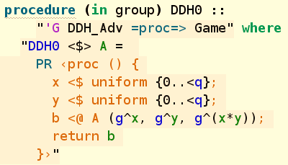
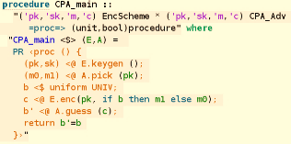
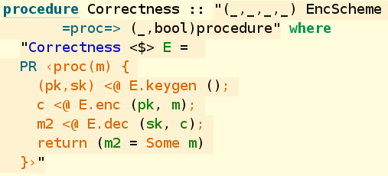
Crypto proofs – bird’s eye view
“Sequences of Games”
(established approach for crypto proofs)
How to prove
relationship?

Slide 20
Verifying game-based proofs: 2 approaches
CryptoVerif approach:
  Have a set of pre-proven rewrite rules
  Automatically apply them to simplify game
EasyCrypt approach:
  User manually writes the games
  User manually proves equivalences in
  “relational Hoare logic”
Hard work,
more powerful
(this talk)

Slide 21
Important insight
Crypto verification boils down
to reasoning about programs
(E.g., Hoare logics and similar)

Slide 22
Relational Hoare Logic (RHL)
Describes relation of two programs
How do the variables of the two programs relate?
Used, e.g., in EasyCrypt for classical verification
(using a probabilistic variant)
$\left\{x=y\right\}$ $x≔x+1 \sim z≔y$ $\{x=z+1\}$

Slide 23
How about quantum?
“Games” may contain quantum vars / quantum operations
Need a quantum version of RHL

Slide 24

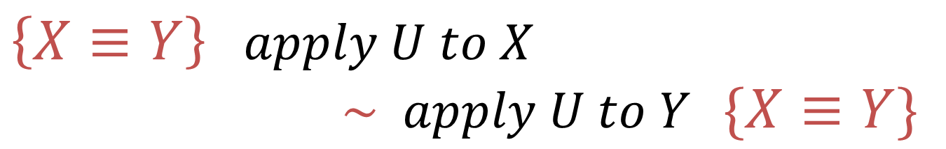
Quantum Relational Hoare Logic (qRHL)
Elementary
while-language
Quantum variables $X,Y$
What does $X≡Y$ mean?
How to formalize semantics of qRHL?
Subspaces
$\left\{X≡Y\right\}$ $apply U to X$
$\sim apply U to Y$ $\{X≡Y\}$
Main source
of trouble:
Entanglement
[U, Quantum Relational Hoare Logic, POPL 2019]

Slide 25
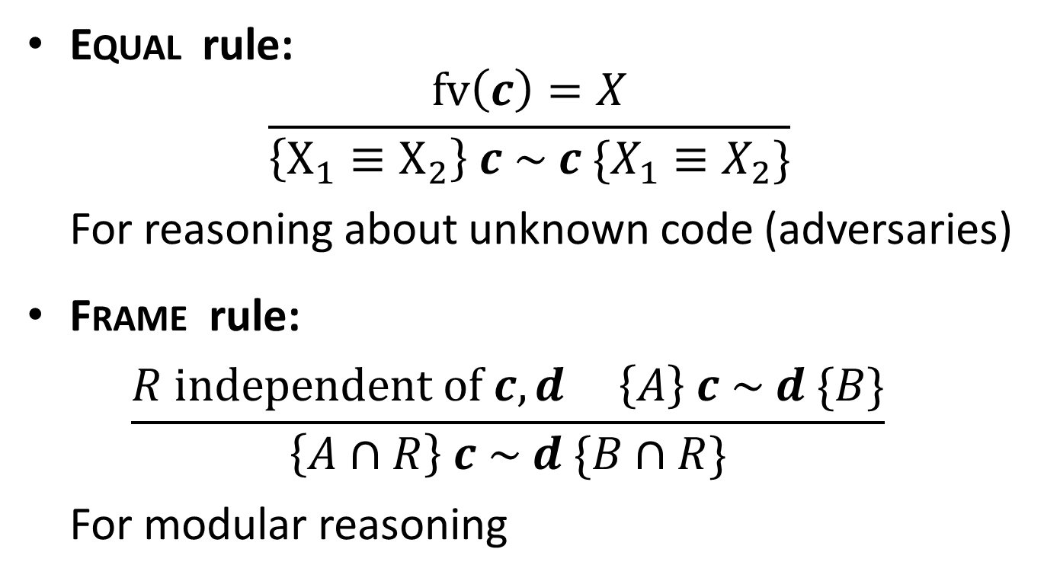
Specific Challenges
Equal rule:
$\frac{fv\left(c\right)=X}{\left\{X_{1}≡X_{2}\right\} c \sim c \{X_{1}≡X_{2}\}}$
For reasoning about unknown code (adversaries)
Frame rule:
$\frac{R independent of c,d \left\{A\right\} c \sim d \{B\}}{\left\{A∩R\right\} c \sim d \{B∩R\}}$
For modular reasoning

Slide 26
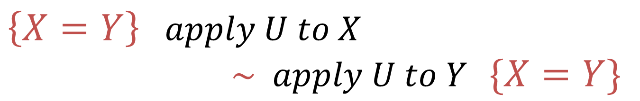
Definition of qRHL
$\left\{X=Y\right\}$ $apply U to X$
$\sim apply U to Y$ $\{X=Y\}$
For two quantum states
that are marginal
of a state satisfying this
After applying
these programs
The final states
are marginal of
some state satisfying this
separable
separable

Slide 27
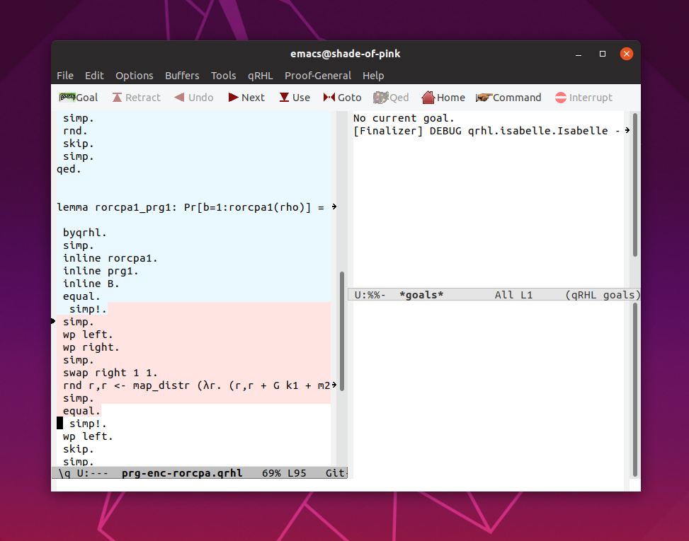
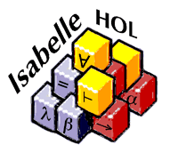
Our Tool
Tactics for qRHL
Verification conditions (VCs):
Inequalities of subspaces
[https://tinyurl.com/qrhl-tool]
Backend for representing
pre-/postconditions
Reasoning about VCs
Smooth path towards full verification

Slide 29
Quantum protocols (beyond classical)
Can we do new things using quantum?
  What if honest parties have Q comm/comp?
Can circumvent classical impossibility
Extra challenges for hardware,
practicality hard

Slide 30

Privacy-preserving data-mining
Encrypted
communication
for data-mining on
sensitive data
With quantum:
Everlasting security.
Attacker:
store and break
years later

Slide 31


Position Verification
Speed of light
→ Position verified

Slide 32

Attack
Copy all data everywhere:
Timing of device
in the middle simulated.
No cloning!

Slide 33
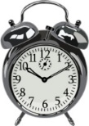



Certified deletion
Compromising
evidence
2 days
Next day:
Still unopened…
1 day

Slide 34
Tools
Easycrpt:
Established for crypto verification,
quantum mode broken.
Qrhl-tool:
Our development.
Still a long way to do.

Slide 35

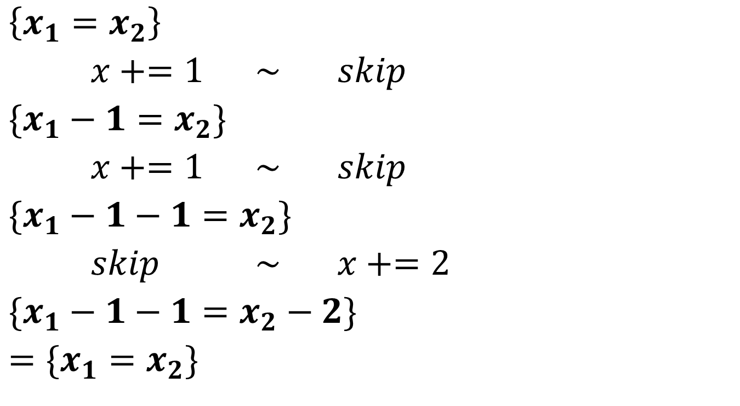
Example derivation
$\left\{x_{1}=x_{2}\right\}$
$x+=1$ $\sim$ $skip$
$\{x_{1}−1=x_{2}\}$
$x+=1$ $\sim$ $skip$
$\{x_{1}−1−1=x_{2}\}$
$skip$ $\sim$ $x+=2$
$\{x_{1}−1−1=x_{2}−2\}$
$=\{x_{1}=x_{2}\}$
$\{x_{1}=x_{2}\}$
$x+=1;x+=1$
$\sim$ $x+=2$
$\{x_{1}=x_{2}\}$

Slide 36
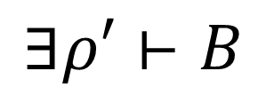
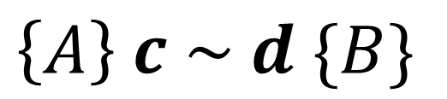
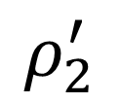
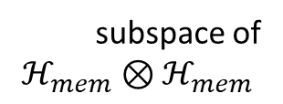
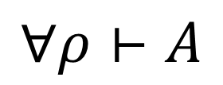
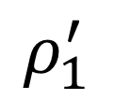

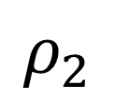

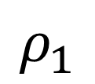

Definition of qRHL (formal)
$$\left\{A\right\} c \sim d \{B\}$$
subspace of
$$ℋ_{mem}⊗ℋ_{mem}$$
$$⟦c⟧$$
$$ρ_{1}$$
$$ρ_{1}^{′}$$
partial
trace
$$∀ρ⊢A$$
$$∃ρ′⊢B$$
separable
partial
trace
separable
$$⟦d⟧$$
$$ρ_{2}$$
$$ρ_{2}^{′}$$
i.e., $supp ρ⊆A$

