Slide 1
Quantum References
Dominique Unruh
U Tartu, RWTH Aachen

Slide 2
Overview
Why quantum registers make me sad
How I got happy again

Slide 3
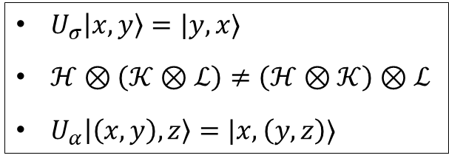



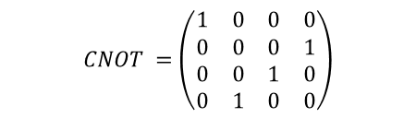
A tiny quantum program
X
apply $H$ on $Y$; apply $CNOT$ on $Z,X$;
Y
H
Z
$$H=\frac{1}{√2}\left(\begin{matrix}1 & 1 \\ 1 & −1\end{matrix}\right)$$
W
$$CNOT =\left(\begin{matrix}1 & 0 & 0 & 0 \\ 0 & 0 & 0 & 1 \\ 0 & 0 & 1 & 0 \\ 0 & 1 & 0 & 0\end{matrix}\right)$$
$$I_{1}⊗H⊗I_{2}$$
$$\left(I_{1}⊗U_{α}\right)⋅U_{α}⋅\left(\left(I_{1}⊗U_{σ}\right)⊗I_{1}\right)⋅\left(U_{α}⊗I_{1}\right)⋅\left(\left(U_{σ}⊗I_{1}\right)⊗I_{1}\right)⋅\left(\left(CNOT⊗I_{1}\right)⊗I_{1}\right)⋅$$
$$\left(\left(U_{σ}⊗I_{1}\right)⊗I_{1}\right)⋅\left(U_{α}^{†}⊗I_{1}\right)⋅\left(\left(I_{1}⊗U_{σ}\right)⊗I_{1}\right)⋅U_{α}^{†}⋅\left(I_{1}⊗U_{α}^{†}\right)$$
$$\left(I_{1}⊗U_{σ}⊗I_{1}\right)⋅\left(U_{σ}⊗I_{2}\right)⋅\left(CNOT⊗I_{2}\right)⋅\left(U_{σ}⊗I_{2}\right)⋅\left(I_{1}⊗U_{σ}⊗I_{1}\right)$$
$U_{σ}\left|x,y\right\rangle =|y,x⟩$
$ℋ⊗\left(𝒦⊗ℒ\right)≠\left(ℋ⊗𝒦\right)⊗ℒ$
$U_{α}\left|\left(x,y\right),z\right\rangle =|x,\left(y,z\right)⟩$

Slide 4

A tiny quantum program
X
apply $H$ on $Y$; apply $CNOT$ on $Z,X$;
Y
H
“Addressing” registers:
Complex even in tiniest programs
More like compiler output than abstract semantics
Could be generated by computer, but: Need semantics of “on register $X$” first
Z
W
$$I_{1}⊗H⊗I_{2}$$
$$\left(I_{1}⊗U_{α}\right)⋅U_{α}⋅\left(\left(I_{1}⊗U_{σ}\right)⊗I_{1}\right)⋅\left(U_{α}⊗I_{1}\right)⋅\left(\left(U_{σ}⊗I_{1}\right)⊗I_{1}\right)⋅\left(\left(CNOT⊗I_{1}\right)⊗I_{1}\right)⋅$$
$$\left(\left(U_{σ}⊗I_{1}\right)⊗I_{1}\right)⋅\left(U_{α}^{†}⊗I_{1}\right)⋅\left(\left(I_{1}⊗U_{σ}\right)⊗I_{1}\right)⋅U_{α}^{†}⋅\left(I_{1}⊗U_{α}^{†}\right)$$
$$\left(I_{1}⊗U_{σ}⊗I_{1}\right)⋅\left(U_{σ}⊗I_{2}\right)⋅\left(CNOT⊗I_{2}\right)⋅\left(U_{σ}⊗I_{2}\right)⋅\left(I_{1}⊗U_{σ}⊗I_{1}\right)$$
$U_{σ}\left|x,y\right\rangle =|y,x⟩$
$ℋ⊗\left(𝒦⊗ℒ\right)≠\left(ℋ⊗𝒦\right)⊗ℒ$
$U_{α}\left|\left(x,y\right),z\right\rangle =|x,\left(y,z\right)⟩$

Slide 5

More “easy” things
In pseudo-code, informal explanations:
“we apply $U$ to $X$ in the diagonal basis” $→$ “$X$ in the diagonal basis” treated as register
“let $X_{i}$ be the $i$-th qubit of $X$” $→$ “$i$-th qubit” is treated as a (sub-)register
“initialize $X,Y$ with an EPR pair” $→$ $X,Y$ is treated like a register (composition)
“measuring position disturbs momentum” $→$ position & momentum are “registers”

Slide 6
Semantics of quantum registers?
Existing approaches:
Lists of qubits / dimension counting
Swaps / associators
Tensor product of family of spaces
Limited and/or complicated

Slide 7

Semantics of quantum registers?!?
Our results
Want:
“What is a register?”
Captures the informal use-examples
No fiddling, clean abstract definition
Independent of memory model
Easy to formalize (e.g., Isabelle/HOL)
Also for classical registers!
(Lenses)
[Image: Wikipedia, Mr. Smiley Face, Otakuma, 0xF8E8]
Notes:
https://commons.wikimedia.org/wiki/File:Mr._Smiley_Face.svg

Slide 8

Classical references (lenses)
Reference with domain $A$ in a memory$M$
Getter + setter (“lens”)
Or: updater $\left(A⇒A\right)⇒(M⇒M)$
Reference F:
Function $F$ from $A\underset{→}{part}A$ to $M\underset{→}{part}M$
Some properties:
$F(f)∘F(g)=F (f∘g)$
etc.

Slide 9
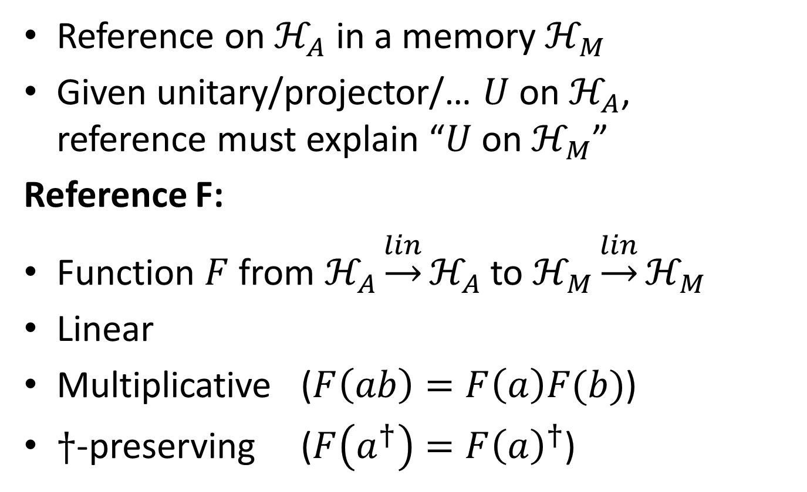
What is a quantum reference?
Reference on $ℋ_{A}$ in a memory $ℋ_{M}$
Given unitary/projector/… $U$ on $ℋ_{A}$, reference must explain “$U$ on $ℋ_{M}$”
Reference F:
Function $F$ from $ℋ_{A}\underset{→}{lin}ℋ_{A}$ to $ℋ_{M}\underset{→}{lin}ℋ_{M}$
Linear
Multiplicative ($F\left(ab\right)=F\left(a\right)F(b)$)
$†$-preserving ($F\left(a^{†}\right)=F{\left(a\right)}^{†}$)

Slide 10

Properties of references
Immediately gives semantics: $⟦apply U on X⟧≔X(U)$
Pairing: For “disjoint” registers $X,Y$, pair$\left(X;Y\right)$ well-defined
Chaining: Register $X$ inside register $Y$. E.g., $i$-th qubit of $Y$.
Basis trafo: Register $X$, basis-transformed via unitary $U$
+ combinations

Slide 11
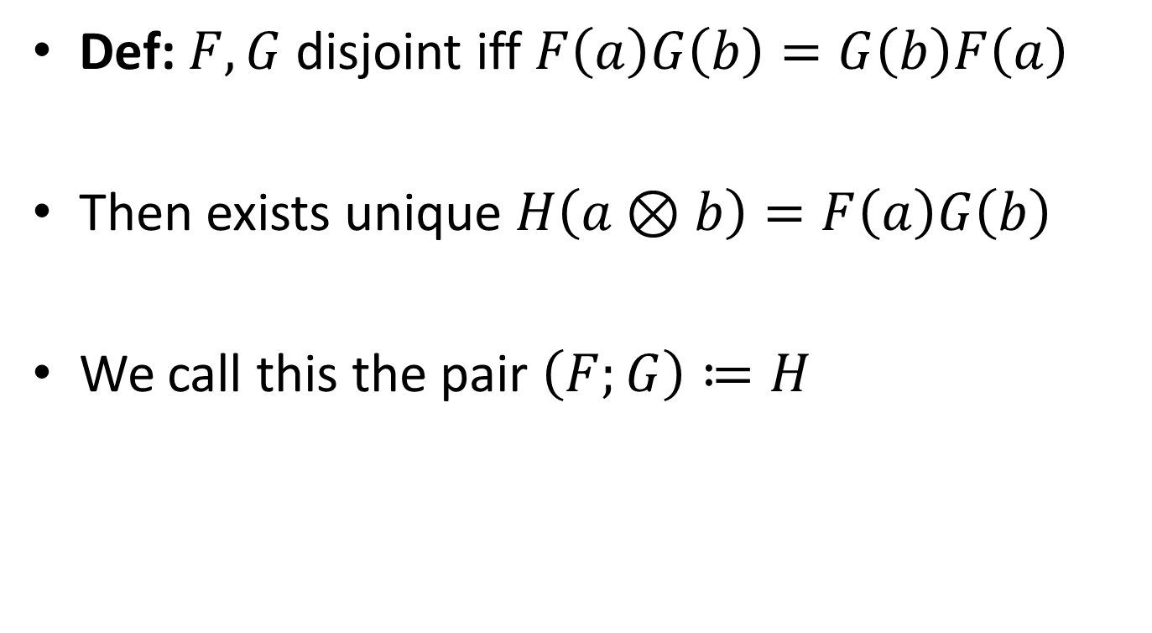
Pairing
Def: $F,G$ disjoint iff $F\left(a\right)G\left(b\right)=G\left(b\right)F\left(a\right)$
Then exists unique $H\left(a⊗b\right)=F\left(a\right)G\left(b\right)$
We call this the pair $\left(F;G\right)≔H$

Slide 12



Tiny program, revisited
Let $X,Y,Z,W$ be arbitrary disjoint references
X
Y
H
Z
W
$$Y(H)$$
$$\left(Z;X\right)\left(CNOT\right)$$

Slide 13
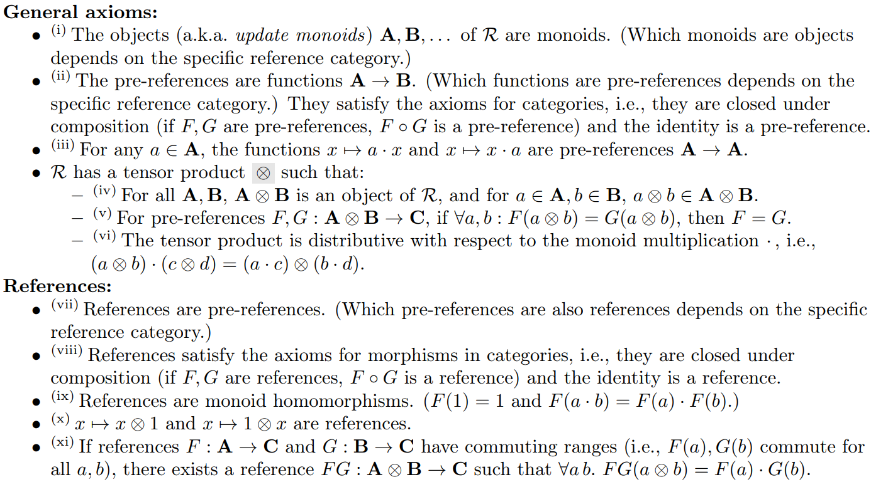
Reference category

Slide 14
Our contribution
Definition of “reference category”
Instantiated quantum/classical
Infinite-dimensional case
Isabelle/HOL formalization
Mini Hoare + teleportation example

Slide 15
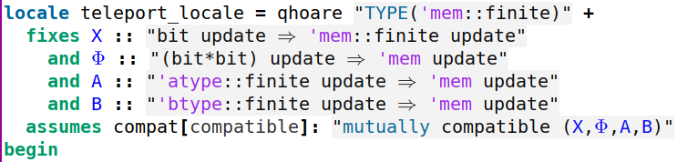
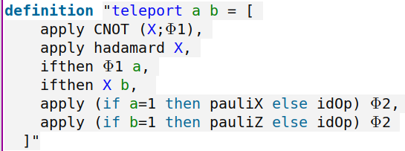

Teleporting Isabelle
Declaring variables
Declaring the program
Hoare logic analysis

